Slide 1


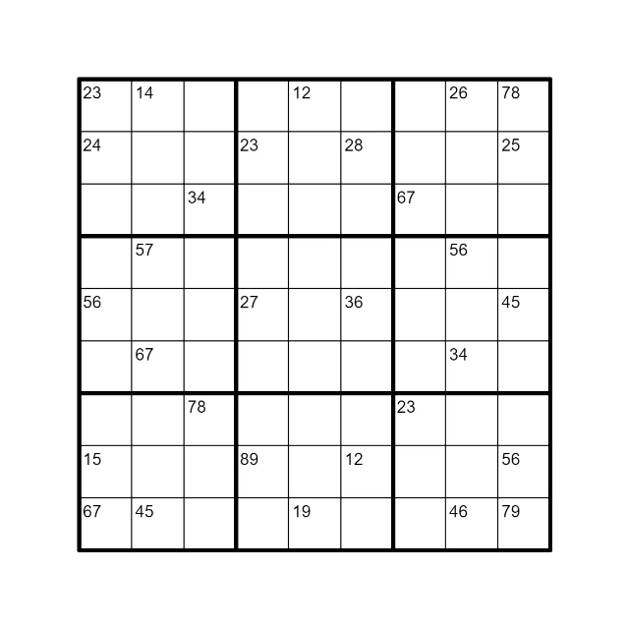


Sudoku Solver Visualizer in Java
Welcome to the Sudoku Solver Visualizer project! This presentation will explore the development and implementation of a Java-based application that solves Sudoku puzzles and visualizes the process.
by Bali Mohan rao

Slide 2

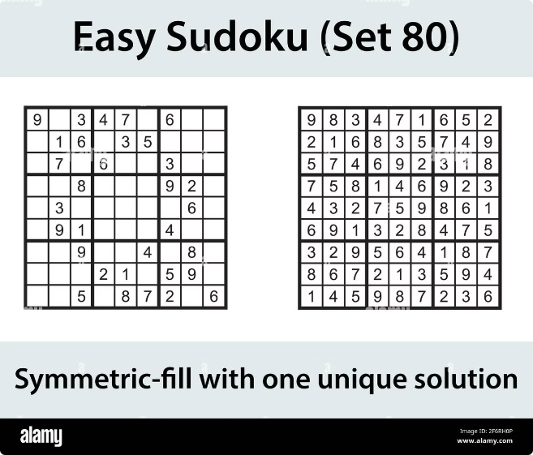
Introduction
Sudoku is a popular logic-based number-placement puzzle. Sudoku solvers employ algorithms to find solutions.
This project aims to create a visualizer that showcases the steps involved in solving Sudoku puzzles.
Interactive Learning
The visualizer allows users to understand the solving process.
Educational Tool
It can be used as a teaching tool for logic and problem-solving.
Puzzle Enthusiasts
The project caters to Sudoku enthusiasts interested in exploring the logic behind solving.

Slide 3

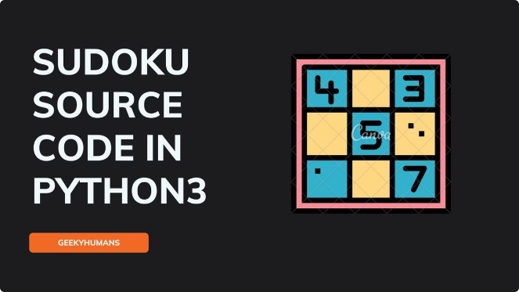
Project Description
The Sudoku Solver Visualizer utilizes a backtracking algorithm to solve puzzles.
The application features a user-friendly interface to input puzzles and visualize the solving process.
The project is developed using Java, leveraging its object-oriented capabilities.
1
Puzzle Input
Users can input Sudoku puzzles using a graphical interface.
2
Solution Visualization
The visualizer dynamically highlights cells as they are solved.
3
Algorithm Steps
Users can observe the backtracking algorithm's steps in action.
4
Performance Analysis
The application provides insights into the solver's efficiency.

Slide 4
Sudoku Solver Algorithm
The backtracking algorithm is a common approach to solving Sudoku puzzles.
It involves systematically trying possible values for empty cells, backtracking when a conflict arises.
Initialization
1
Start with an empty solution grid.
2
Cell Selection
Select an empty cell in the puzzle.
Candidate Value
3
Try a candidate value for the selected cell.
4
Check Constraint
Verify if the candidate value satisfies Sudoku rules.
Recursion
5
Recursively repeat steps for remaining empty cells.
6
Backtracking
If a conflict occurs, backtrack to the previous cell and try another value.

Slide 5
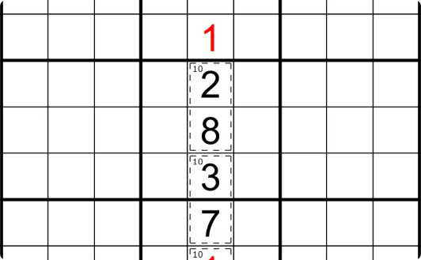
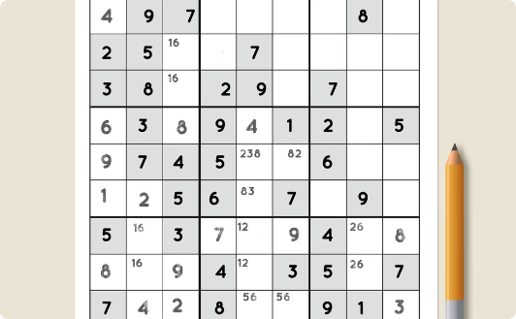
Visualization Techniques
The visualizer employs various techniques to effectively represent the solving process.
Dynamic highlighting, color changes, and animation are used to enhance user understanding.
Row Highlighting
Column Highlighting
Block Highlighting
Highlighting the row of a selected cell.
Highlighting the column of a selected cell.
Highlighting the 3x3 block of a selected cell.

Slide 6
User Interface Design
The user interface is designed to be user-friendly and intuitive.
Users can easily input puzzles, control the visualization speed, and observe the solving process.
Input Area
Visualization Panel
Control Panel
A grid for users to input Sudoku puzzles.
Displays the solving process with dynamic updates.
Buttons for starting, pausing, and controlling visualization speed.

Slide 7


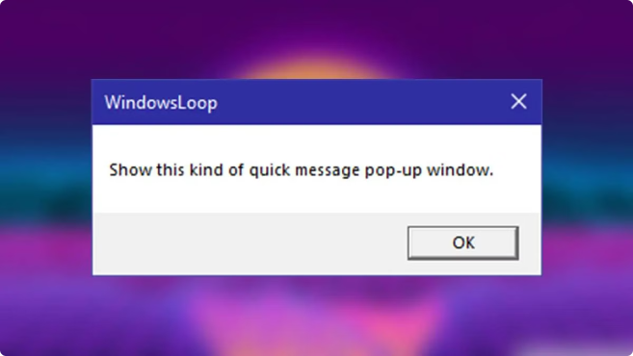


Handling Invalid Inputs
The application validates user input to ensure it conforms to Sudoku rules.
Error messages are displayed to guide users in correcting invalid input.
Input Validation
Checks for correct digit range (1-9).
Duplicate Check
Ensures no duplicate digits in rows, columns, or blocks.
Error Handling
Displays error messages for invalid input.

Slide 8


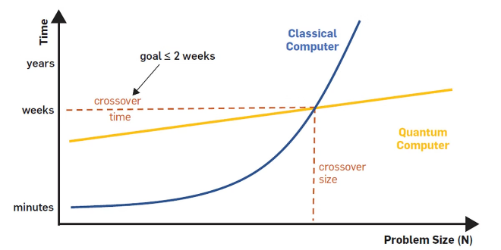


Optimizing Performance
Performance optimization is crucial for a smooth user experience.
The application employs techniques to reduce processing time and improve responsiveness.
Efficient Algorithm
The backtracking algorithm is optimized for speed.
Memory Management
Efficient data structures are used to minimize memory usage.
Data Caching
Storing frequently used data for faster access.

Slide 9

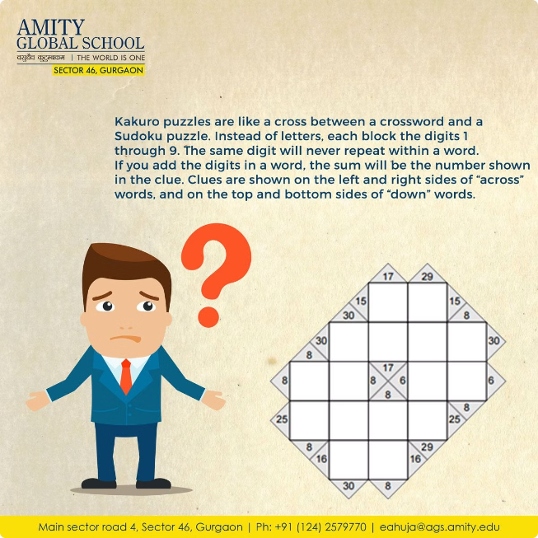
Challenges and Limitations
There are inherent challenges associated with solving Sudoku puzzles.
The complexity of the problem can lead to performance limitations for very large or difficult puzzles.
Complexity
Sudoku puzzles can have varying difficulty levels, impacting solving time.
Memory Usage
Storing and processing puzzle data can require significant memory.
Visualization Overhead
Dynamic visualizations can add computational overhead.

Slide 10

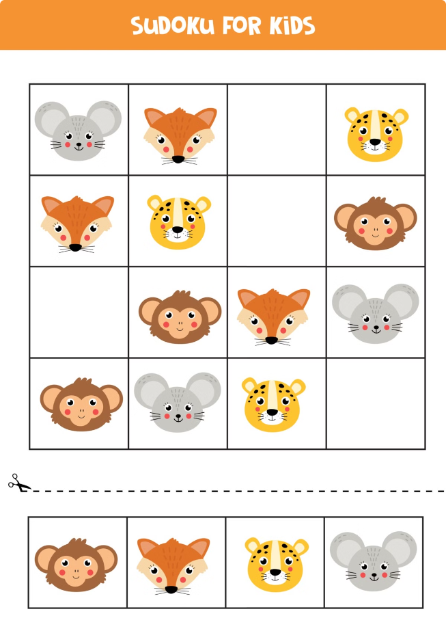
Conclusion and Future Enhancements
The Sudoku Solver Visualizer provides an interactive and educational tool for exploring Sudoku puzzles.
Future enhancements include adding advanced algorithms, incorporating puzzle difficulty levels, and developing a mobile version of the application.
1
Advanced Algorithms
Exploring more efficient Sudoku solving algorithms.
2
Difficulty Levels
Adding features to classify puzzle difficulty.
3
Mobile Application
Creating a mobile version for wider accessibility.

